Slide 1
Word Order in News Texts
Corpus Crew (Group 10) Assylbek Tleules – 12432843 Emily Jacob – 12143768 Luka Santek – 12332270 Tehseen Ali Tahir - 12433763

Slide 2
Research Question
“What is the distribution of word order types (SVO, SOV, VSO, etc.) in each language?”
“Do flexible-order languages (e.g., Spanish, Greek) show an increased preference for SVO
after 2022 compared to before?”

Slide 3
Data Collection
Source: Leipzig News Corpora
Languages: English, Russian, German
Number of sentences/year: 10,000
English: 2018, 2019, 2020, 2023, 2024
German: 2019, 2022, 2023, 2024
Russian: 2013, 2019, 2020, 2022, 2024

Slide 4
Preprocessing Pipeline
1. Data Merge/Cleaning
Merge datasets and metadata
Remove URLs, HTML tags, extra whitespace
Strip quotes and normalize punctuation
2. Filtering
Remove duplicate sentences
Remove sentences < 8 tokens
3. Metadata Handling
Preserve: year, source, date, language
Label Pre/Post GPT based on date metadata
4. Output
Clean TSVs per language: language_year.tsv
After pre-processing, we were left with 154k sentences ready for Stanza annotation!

Slide 5
Lingustic Annotation
Stanza models loaded per language: en, de, ru
Processed with:
Tokenization → split sentences into words/punctuation
Lemmatization → normalize words to base form
POS tagging → identify nouns, verbs, etc.
Dependency parsing → find grammatical relationships (subject → verb → object)
Output
Each sentence annotated in CoNLL-U format
Metadata preserved: year, period, sentence ID, sentence as comments
Ready for Ground Truth and Rule-based/ML classifiers

Slide 6
Ground Truths using Stanza
3 Step Algorithm:
1. Find root verb - Looks for: deprel='root' and POS='VERB'/'AUX’
2. Extract S & O connected to root verb:
Subject: deprel='nsubj', head=root_verb_id
Object: deprel='obj', head=root_verb_id
Constraint: must point to main verb
3. Compare positions -> classify order
SVO, SOV, VSO, VOS, OSV, OVS
Partial orders: SV_only, VO_only, SO_only
If missing -> INCOMPLETE
Limitations:
Parser errors - 15-25% of labels may have parser errors
Main clause only - Ignores subordinate clauses
Coordination - Takes first subject/object only

Slide 7
Stanza Annotation Evaluation
Evaluation of Stanza Annotations
Manually annotated Subject, Verb, Object order of 20 sentences from the test set to evaluate Stanza ground truth.
Metric: Exact word order match
Overall Accuracy: 55% (33/60 correct)
Per language accuracy:
Russian – 70% (14/20 correct)
English – 65% (13/20 correct)
German – 30% (6/20 correct)
Implies language-specific extraction issues.

Slide 8
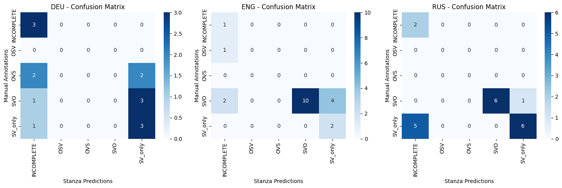
Confusion Matrix: Per Language

Slide 9
Error Analysis: Insights
Russian:
Stanza dependencies are reliable. -> mostly correct SVO.SOV classifications.
English:
Failed to extract objects correctly -> SVO is sometimes misclassified as SV-only or VO-only.
German:
Extraction fails to differentiate auxiliary verb and lexical verb

Slide 10
Rule-Based Baseline: Simple Heuristic
4 Step Algorithm:
Find first verb - scan left to right, stop at first VERB or AUX
Look before the verb - are there any nouns/pronouns?
Look after the verb - are there any nouns/pronouns?
Classify:
Nouns both before AND after -> must be SVO!
Only before -> SV_only
Only after -> VO_only
Neither -> INCOMPLETE
The problem: It doesn't understand which nouns go with which verbs. It just assumes positional proximity = relationship.

Slide 11
Rule-Based Baseline: POS pattern
3 Step Algorithm:
1. Collect all positions
Make a list of all nouns with their positions: [(N, 2), (N, 5), (N, 8)]
Make a list of all verbs with their positions: [(V, 3), (V, 10)] Look after the verb - are there any nouns/pronouns?
2. Pick candidates:
Subject = first noun
Verb = first verb
Object = second noun
If we dont have at least 2 nouns and 1 verb -> INCOMPLETE
3. Compare positions and classify:
If N1 < V < N2: SVO (noun, verb, noun)
If N1 < N2 < V: SOV (noun, noun, verb)
If V < N1 < N2: VSO (verb, noun, noun)
It still doesn't understand GRAMMAR. It just looks at word category (noun vs verb) and position.

Slide 12
ML Classifier for Word Order
Stanza as a ground truth
Algorithms: SVM, Naïve Bayes, Logistic Regression
Feature extractors: BoW, TF-IDF
Workflow:
Perform cross-validation and hyperparameter tuning on the training set using GridSearchCV
Select the best hyperparameter configuration for each (model, feature extractor) combination based on weighted F1-score.
Evaluate the best configuration of each combination on a held-out validation set.
Compare models using validation metrics (F1, balanced accuracy, precision, recall) and select the overall best-performing model.
Leave the test set unseen for final comparison with rule-based models
Final best model was chosen based on in-depth analysis and evaluation on test set
Evaluation was done separately for binary classification and multiclass classification task

Slide 13
Evaluation: ML Classifier
Evaluation Setup:
Train /validation split
GridSearchCV with cross-validation
Metrics used:
Accuracy
Balanced Accuracy
Macro F1
Why balanced metrics?
Strong class imbalance (SVO dominates)
Accuracy alone would overestimate performance
BEST Multiclass ML MODEL:
Logistic Regression -> Bal. Accuracy of 46.1 %

Slide 14
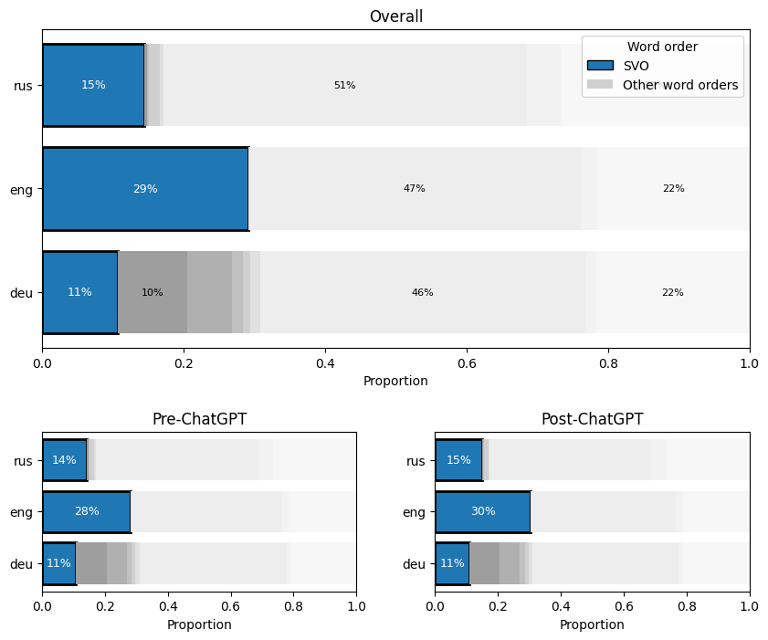
Insights

Slide 15
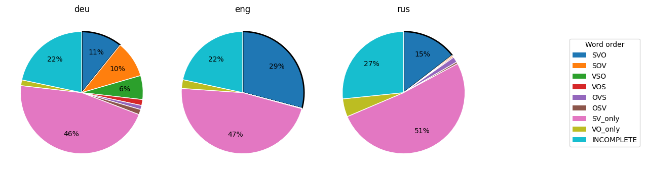
Insights

Slide 16
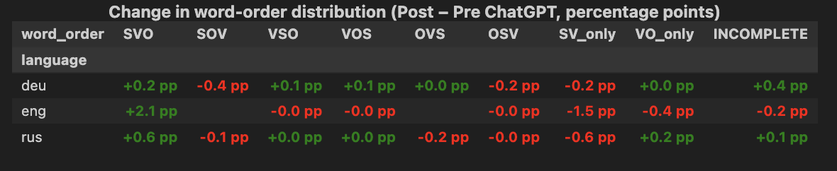
Insights

